Slide 1
Introduction to Algorithms
Zhenlin Wang

Slide 2
About this course
Text:
  Introduction to Algorithms by T. H. Cormen at el., 2nd edition
We meet TR 2:05 PM – 3:20 PM at Fisher 325
Office hours: MW 1:30 PM – 3 PM

Slide 3
Course administration
Homework
  6-7 assignments, 25%
  Encouraged to form discussion groups, but you need to finish your work independently
One in-class midterm (around Oct. 23), 25%
Final (comprehensive), 35%
Class participation & Quizzes 15%
  Five to six quizzes
  50% participation credits

Slide 4
Recommendations
This is a challenging course!!
  My job is to make it easier and more enjoyable
  Your job is to work hard
Come to class
Web page
  Homework, examples, hints
See your instructor for help
  You are welcome when my door is open (almost always)
  Topics not limited to this course

Slide 5
Major topics
Algorithm design and analysis
  Efficiency: worst case, best case, and average, amortized analysis
Asymptotic notations
  O, Ω, o, ω
Data structures
  Heap, binomial heap, disjoint sets, trees, graphs
Design Paradigms
  Greedy, divide-and-conquer, dynamic programming
P and NP problems
  Reduction, complexity

Slide 6
Topics and Exams
Topics | Reading
Introduction | 1
Induction and loop invariants | 2.1
Asymptotic Notation | 3.1-3.2
Algorithm Analysis - Analyzing control structures - Worst-case and Average-case - Amortized analysis | 2.2 5.1-5.3 17.1-17.3
Solving Recurrences | 4.1-4.3
Heap and Heap Sort | 6
Binomial Heaps | 19

Slide 7
Topics and Exams
Topics | Reading
Splay Trees | Notes, handouts
Disjoint Set | 21.1-21.3
Greedy Algorithms - Minimum Spanning Tree - Dijkstra’s algorithm - Knapsack - Scheduling | 16.1-16.2 16.5 23 24.3
In-class mid term (around Oct. 23)
Divide-and-Conquer - Mergesort and Quicksort - Median - Closest pair | 2.3 7.1-7.4 9

Slide 8
Topics and Exams
Topics | Reading
Dynamic Programming - Assembly line scheduling - Longest common subsequence - Floyd’s algorithm - Matrix chain | 15.1-15.4 25.1-25.2
Exploring Graphs - Graph Search - Topological sorting | 22.1-22.4
Network Flow and Matching | 26.1-26.3
Decision Trees and Low Bound Arguments | 8.1
P and NP Problems | 34-35
Final

Slide 9
Algorithmics, Data Structures and Discrete Structures
Algorithms
  Thought and presented according to design techniques rather than by application domain
  Focus on efficiency, complexity, and correctness
Data structures
  Focus on data organizations accompanied by related algorithms
Discrete structures
  Mathematical properties of data structures

Slide 10
Why this course?
Algorithm
  A sequence of computational steps that transform the input to the output
  For example, sorting
    Input: an array of n elements
    Output: an sorted array that is a permutation of the input
Algorithmics
  The systematic study of the design and analysis of algorithms
Our goal
  Given a problem, be able to design an efficient algorithm (be able to analyze your algorithm) and prove the algorithm works

Slide 11
Pitfall: machine is so cheap, so the efficiency of an algorithm is not important
Moore’s law
  Processor’s speed doubles every 18 months
  A typical 2006 machine is 64 times faster that one in 2000
2000 | 512 MHZ
2003 | 2-3GHZ
2006 | Multicore 2GHZ * 4

Slide 12
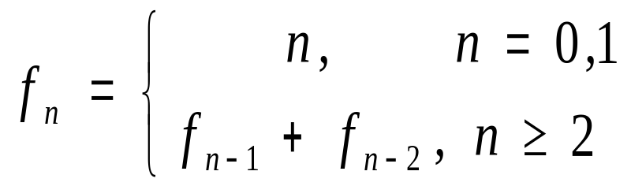
Example: Fibonacci Sequence
Definition
Algorithms to generate the n^{th} Fibonacci number
  Recursive algorithm
  Iterative algorithm

Slide 13
Iterative vs. Recursive Algorithm
double fibIterative(int n)
{
double Fn_1, Fn_2, Fn;
int i;
if (n<2)
return ((double)n);
Fn_2 = 0;
Fn_1 = 1;
for (i=2; i<=n ; i++) {
Fn = Fn_1 + Fn_2;
Fn_2 = Fn_1;
Fn_1 = Fn;
}
return Fn;
}
double fibRecursive(int n)
{
double ret;
if (n<2)
ret = (double)n;
else
ret = fibRecursive(n-1) +
fibRecursive(n-2);
return ret;
}

Slide 14
Experimental comparison
n | Recursive | Iterative | Recursive/ Iterative
4 | 0.27 ms | 0.03 ms | 9
8 | 0.71 ms | 0.05 ms | 14
16 | 27 ms | 0.14 ms | 193
32 | 0.28 sec | 0.32 ms | 875
64 | > 3300 mins | 0.64 ms | > 3*10¹¹

Slide 15
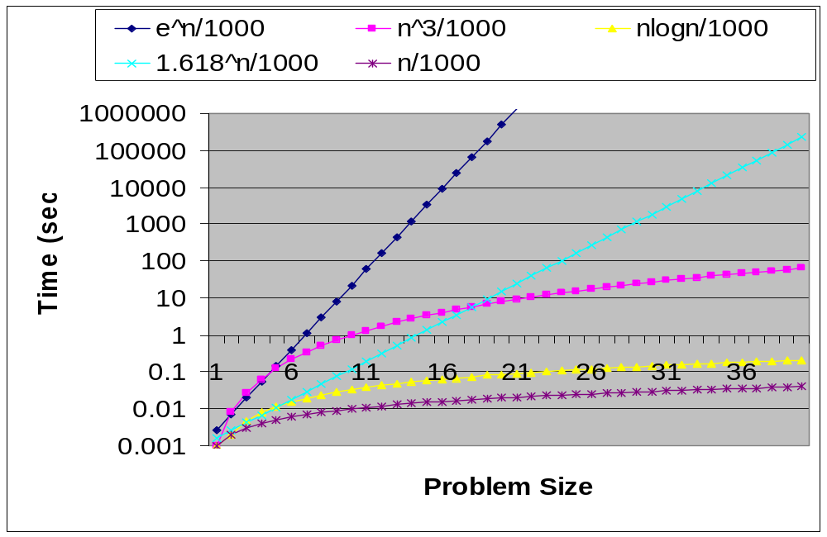
Execution time versus problem size

Slide 16

Fibonacci Sequence Algorithms
Design
  We saw two implementations (top-down/bottom-up methods are used here).
Correctness
  How can we prove the two algorithms compute f_{n}?
Efficiency
  How can we show that the execution time of the iterative algorithm is proportional to n while the recursive algorithm to , when n is sufficiently large?

